Slide 1
LoRa Buffer
respberry
Receiver
smart meter
package
smart gateway
Payload 1
package
Payload 2
Payload 3
package
queue
Transform into str
analyze

Slide 2
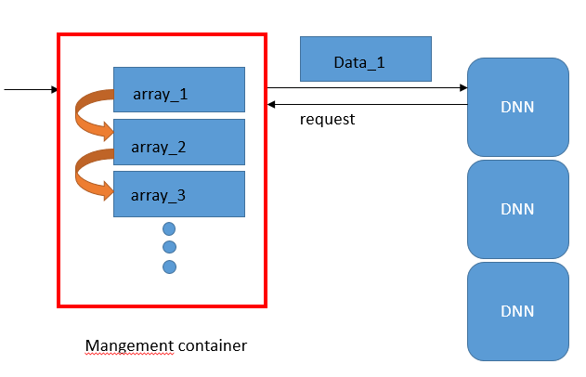
Container Buffer
Transform into str
smart gateway
Management Container

